Slide 1
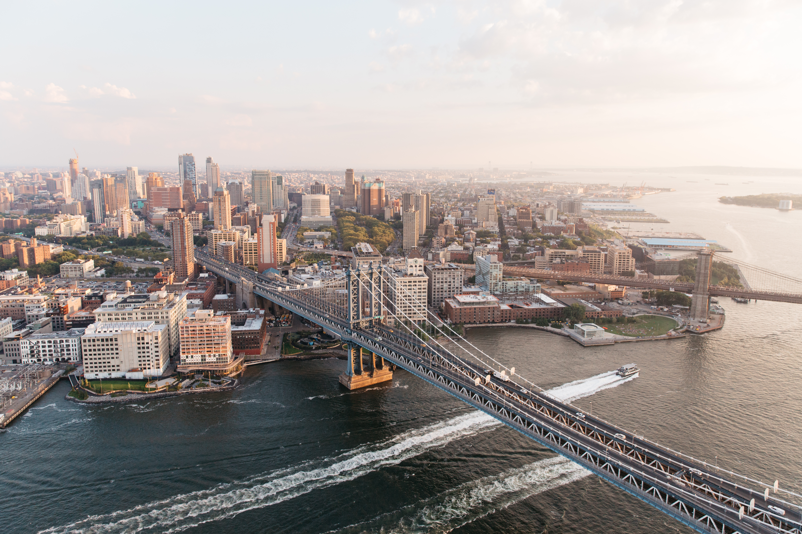
MAINSTREAM SOCIAL MEDIA MARKETING
STRATEGY AND IMPLEMENATION PLAN
{Jung education}
{Yangha Park}
{10/5/2018}

Slide 2
contents
Organisation overview and research
Mainstream social media marketing strategy
Implementation plan

Slide 3
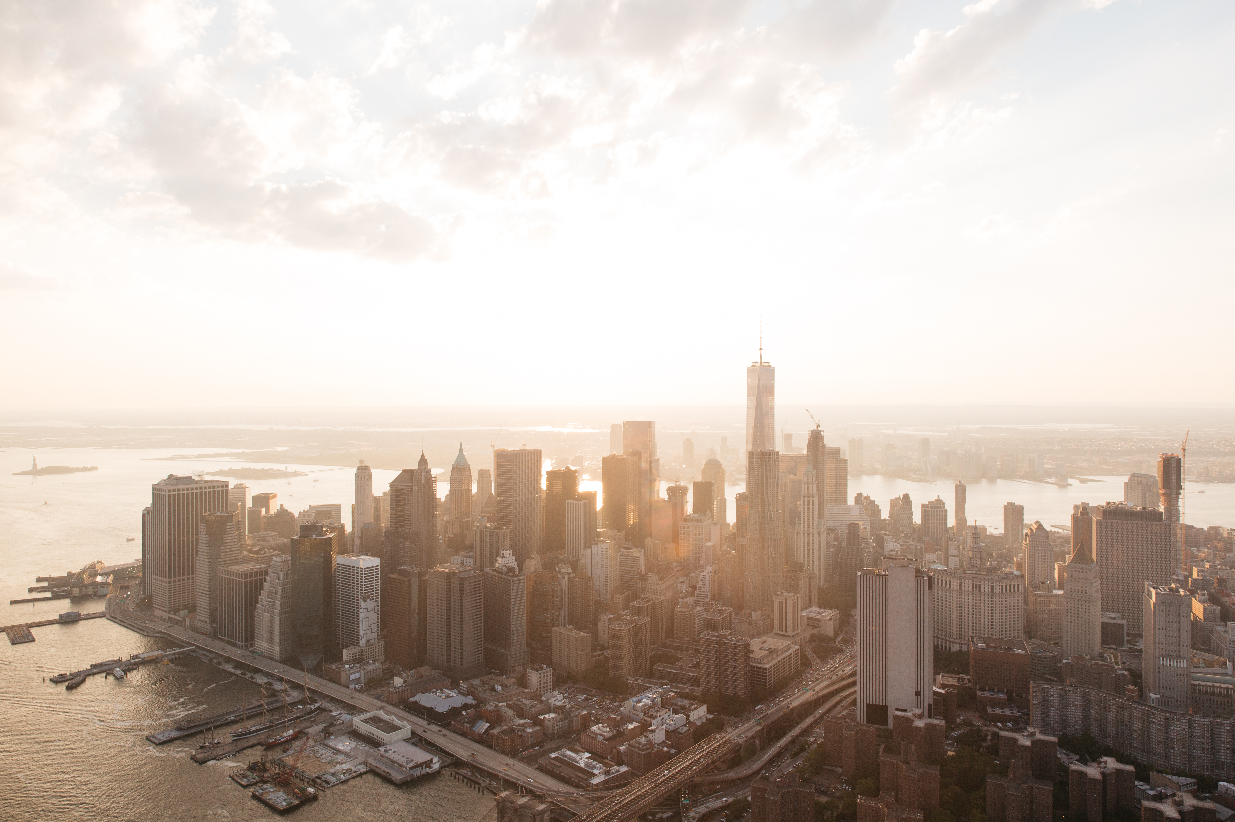
Stage 1.
Organisation OVERVIEW AND RESEARCH

Slide 4
ORGANISATION OVERVIEW
Provide an overview of the organisation you have selected for the purpose of this assessment and answer the key questions below in your description.
What is the name of the organisation? Jung Education
Please provide a brief history of the organisation. Established in 2006
What products and/or services does the organisation offer? Education
What is the pricing tier of the products and/or services offered?
What are the main sales channels?
Where is the organisation located?
What geographies does the organisation work in?
Who is the organisation’s target audience?

Slide 5
GENERAL MAINSTREAM SOCIAL MEDIA NETWORK OVERVIEW
Channel | Key features | Marketing Opportunities | Primary audience | Paid vs free features
Facebook
Twitter
LinkedIn
Instagram
Pinterest
Google +
YouTube

Slide 6
MAINSTREAM SOCIAL MEDIA MARKETING PROFILE AUDIT
Channel | Profile/website URL | Profile Activity (1 = post < once per month 5 = post everyday) | Page relevant and is the profile up to date? (Yes/no) | Admin owner(s) | Type(s) of content posted | Audience engagement level (volume of likes/shares/tweets, etc.)
Blog / Website | https://blog.naver.com/happy_guys | 1 | No | Yes | Posts related to schools in Australia | 0
Facebook | https://www.facebook.com/jungeducation/ | 1 | no | Yes | Events, updates | 0
Twitter
Instagram
Pinterest
Google +
LinkedIn
YouTube

Slide 7
MAINSTREAM SOCIAL MEDIA MARKETING STRATEGY AND CAMPAIGN AUDIT
Type | Currently active? | Activity type | Frequency | Social Media Network | Sponsored / Promoted | Owner / Resource
Owned Content | No | Event | Once per month | Facebook | No | N/A
 |  |  |  | Naver blog | No
3rd Party Content | Yes | Promotion of colleges in Australia | Once per month | Naver blog | No | N/A
Paid Ads | N
Promotional Posts | N
Community Management | N

Slide 8
MAINSTREAM SOCIAL MEDIA NETWORK
Content CONSTRAINTs
Category | Constraint/Requirement
When not to post | When there is negative publicity about the organization and/or industry, when there is some serious issues about Australia.
What not to post | Racism, inappropriate language, something disrespectful to stakeholders, and/or competitors.
Where not to post | Korea Government website, Competitors’ blogs or websites or social media channels or groups. Blogs, groups, social media channels where our audience is not there.
Who not to target | Elder people, People that don’t speak Korean, People that are not interested in moving to Australia.

Slide 9
MAINSTREAM SOCIAL MEDIA NETWORK
GLOBAL TRENDS AND OPPORTUNITIES
Case Study | Organisation 1< Go Study > | Organisation 2< Information Planet Australia > | Organisation 3
Social Media Network | Facebook, Twitter, YouTube, Instagram.
Geography | Sydney, Australia.
Marketing Objective | Increasing the number of customers and brand awareness.
Marketing Solution | Very active on social media. They created a lot of video content. They use testimonials.
Primary Benefit(s) | They helped 20,000 people in 10 years.
Secondary Benefit(s) | Increasing fans on Instagram and engagement on this social media channel.

Slide 10
Stage 2.
MAINSTREAM SOCIAL MARKETING STRATEGY

Slide 11
MAINSTREAM SOCIAL MEDIA
TARGET AUDIENCE SEGMENTS
1
2
3

Slide 12
MAINSTREAM SOCIAL MEDIA
TARGET AUDIENCE CANVAS #1
Target audience name: _____________________________________________________
Target audience demographic and characteristics | Goals | Buying process |  |  | Influencers/stakeholders/buyer teams
 |  | Timing |  | Sales channels | Social media networks
Questions they ask the organisation |  |  | Content/information that engages them

Slide 13
MAINSTREAM SOCIAL MEDIA
TARGET AUDIENCE CANVAS #2
Target audience name: _____________________________________________________
Target audience demographic and characteristics | Goals | Buying process |  |  | Influencers/stakeholders/buyer teams
 |  | Timing |  | Sales channels | Social media networks
Questions they ask the organisation |  |  | Content/information that engages them

Slide 14
MAINSTREAM SOCIAL MEDIA
STRATEGIC IDEAS
Primary Objective | Category | Content Ideas | Second Marketing Benefits

Slide 15
MAINSTREAM SOCIAL MEDIA
STRATEGY
Strategic Initiatives | Campaign/always on | Content Idea | Social media network(s) | Frequency (must run over at least 3 weeks) | Key Performance Indicators (KPIs) | KPI Targets (per month)
1
2
3

Slide 16
MAINSTREAM SOCIAL MEDIA
STRATEGY SUMMARY
Category | Facebook | Twitter | LinkedIn | Instagram | Pinterest | Google+ | YouTube
Owned media | (Tick and list where applicable) | Eg: ✓ Industry news
Promotional
Third party media
Paid Media
Community Management

Slide 17
MAINSTREAM SOCIAL MEDIA
BUDGET OVERVIEW
Campaign | Expense Category | Expense Item | Forecasted Monthly Budget | Reporting Frequency | Budget Approval
Overall
Campaign 1
Campaign 2
Campaign 3
Totals___

Slide 18
Stage 3.
MAINSTREAM SOCIAL MARKETING IMPLEMENTATION PLAN

Slide 19
MAINSTREAM SOCIAL MEDIA
IMPLEMENTATION PLAN
Campaign | Actions required | Task owner | Start date | End date
#1
#2
#3

Slide 20
MAINSTREAM SOCIAL MEDIA
AUDIENCE FEEDBACK PROCEDURE
Type of comment | Enquiry | Positive comment | Neutral | Negative comment
 |  |  |  | Genuine feedback | Negative comments | Offensive/spam | Serious issue
Description
Example
Recommended response and action

Slide 21
MAINSTREAM SOCIAL MEDIA MANAGEMENT PLATFORM EVALUATION
Social Media Management Platform | Advantages | Disadvantages | Price | Selection (tick which will be utilised for this organisation)

Slide 22
MAINSTREAM SOCIAL MEDIA
STRATEGY MANAGEMENT SCHEDULE
Campaign Name | Content Strategy | Date / Time | Social Media Networks | Imagery | Target Audience | Resources Required | Campaign Manager | KPI Targets
 |  |  |  | Imagery
 |  |  |  | Imagery
 |  |  |  | Imagery

Slide 23
MAINSTREAM SOCIAL MEDIA
CAMPAIGN 1 CONTENT
Detail the content for the first campaign of the mainstream social media marketing strategy including the headline, any imagery and associated links that will be included where applicable.
Social media network | Content Type | Post Content | Associated Imagery | Associated Link / Tags (if applicable)

Slide 24
MAINSTREAM SOCIAL MEDIA
CAMPAIGN 2 CONTENT
Detail the content for the second campaign of the mainstream social media marketing strategy including the headline, any imagery and associated links that will be included where applicable.
Social media network | Content Type | Post Content | Associated Imagery | Associated Link / Tags (if applicable)

Slide 25
MAINSTREAM SOCIAL MEDIA
CAMPAIGN 3 CONTENT
Detail the content for the third campaign of the mainstream social media marketing strategy including the headline, any imagery and associated links that will be included where applicable.
Social media network | Content Type | Post Content | Associated Imagery | Associated Link / Tags (if applicable)

Slide 26
SMMMSM502A
Make
An
Impact

